Slide 1
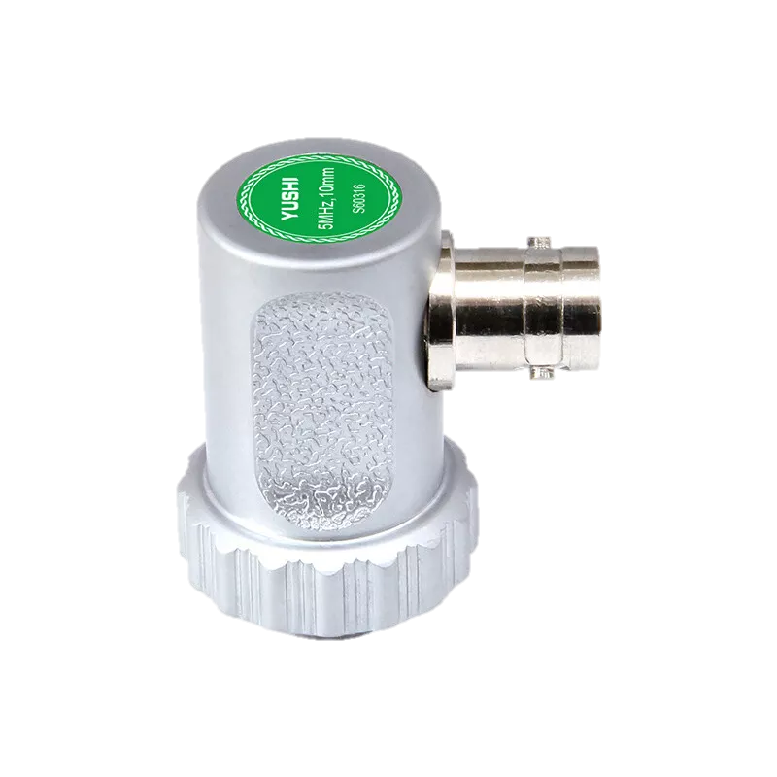
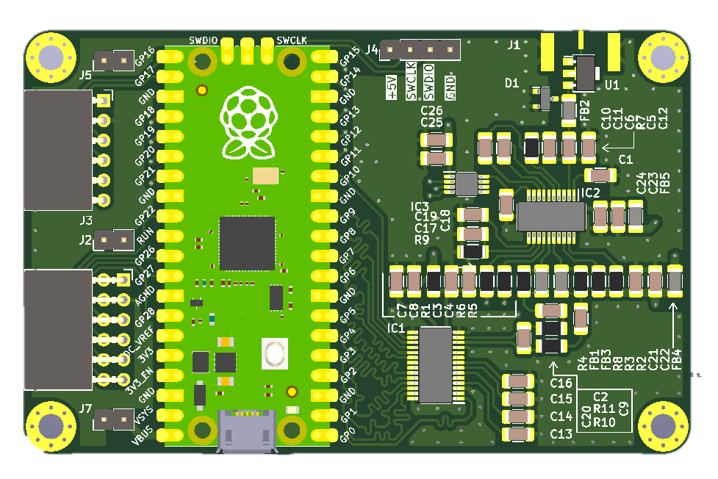
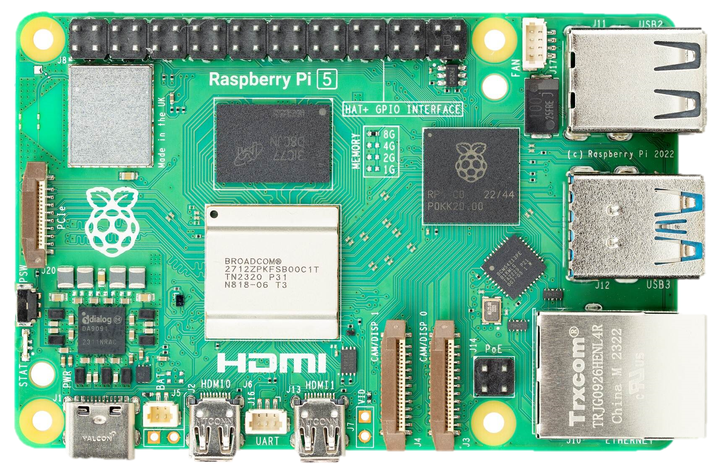
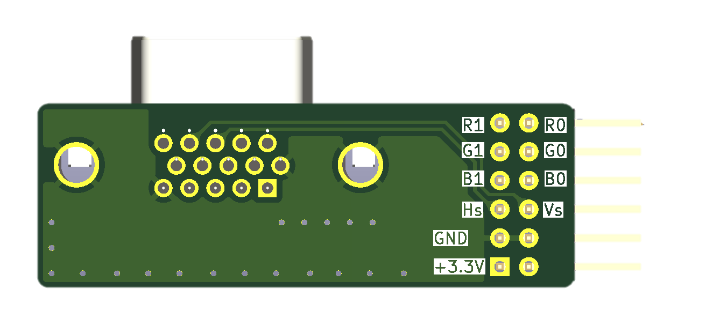
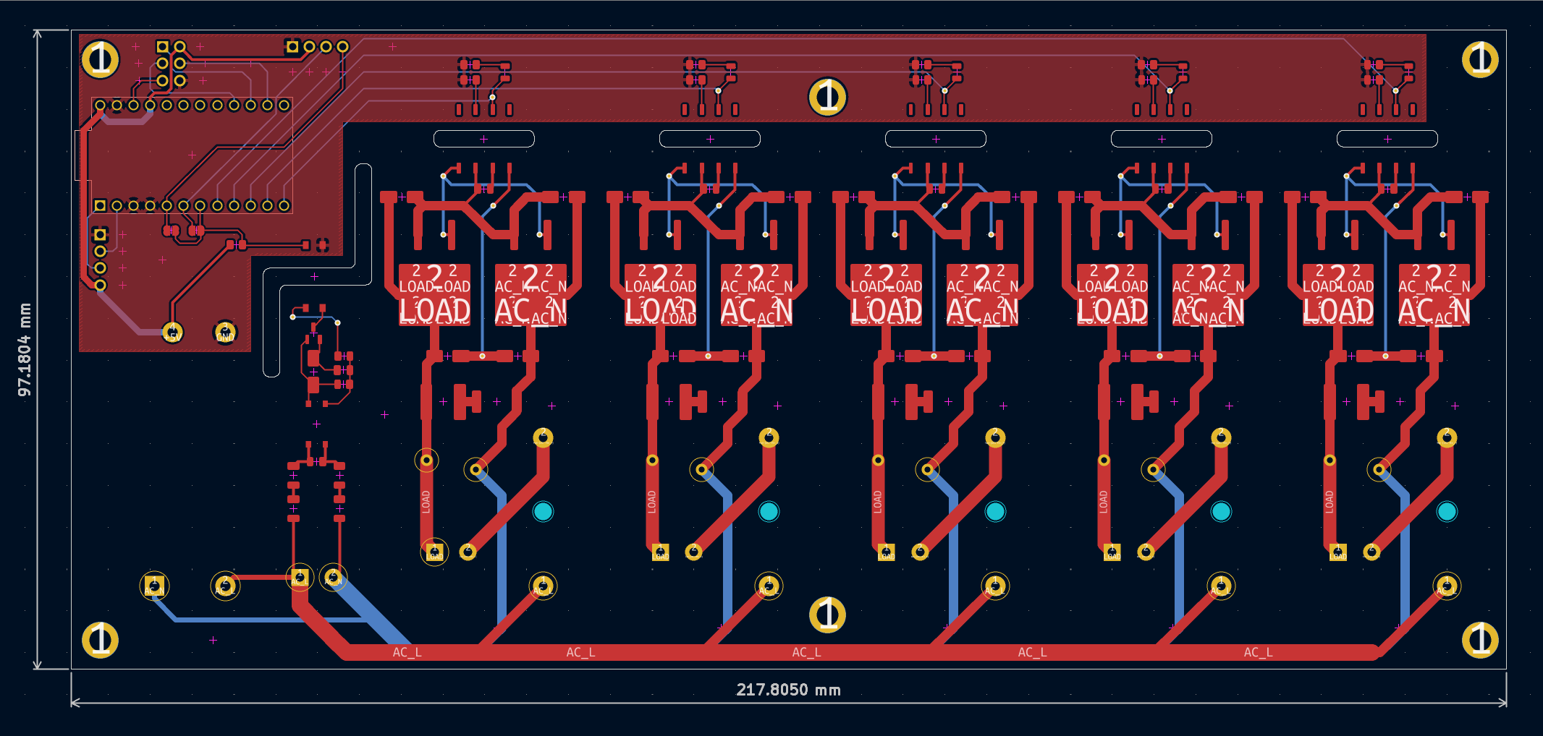
Design & Development of a Portable Cost-effective
DIY Ultrasound Imaging System
April 25th, 2025
CPS489Y5
Yimin Xu

Slide 2




Motivation
Scientific Background
Design & POC
Initial Steps
Design & Development of Ultrasound Probe
Research, Design & Development of Imaging System
Lens
Acoustic Stacks
Flex Circuit
Interconnector
tissue mimetic
ultrasound
probe
4k monitor
Miniature Coax
Proof of Concept with Custom Built Raspberry Pi, Arduino & NVIDIA Imaging Platform

Slide 3
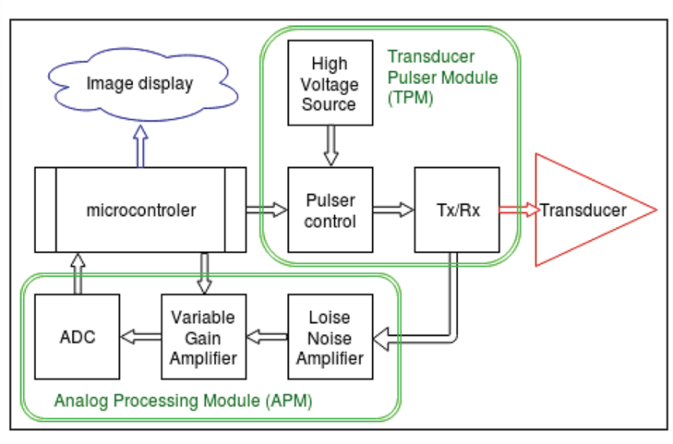
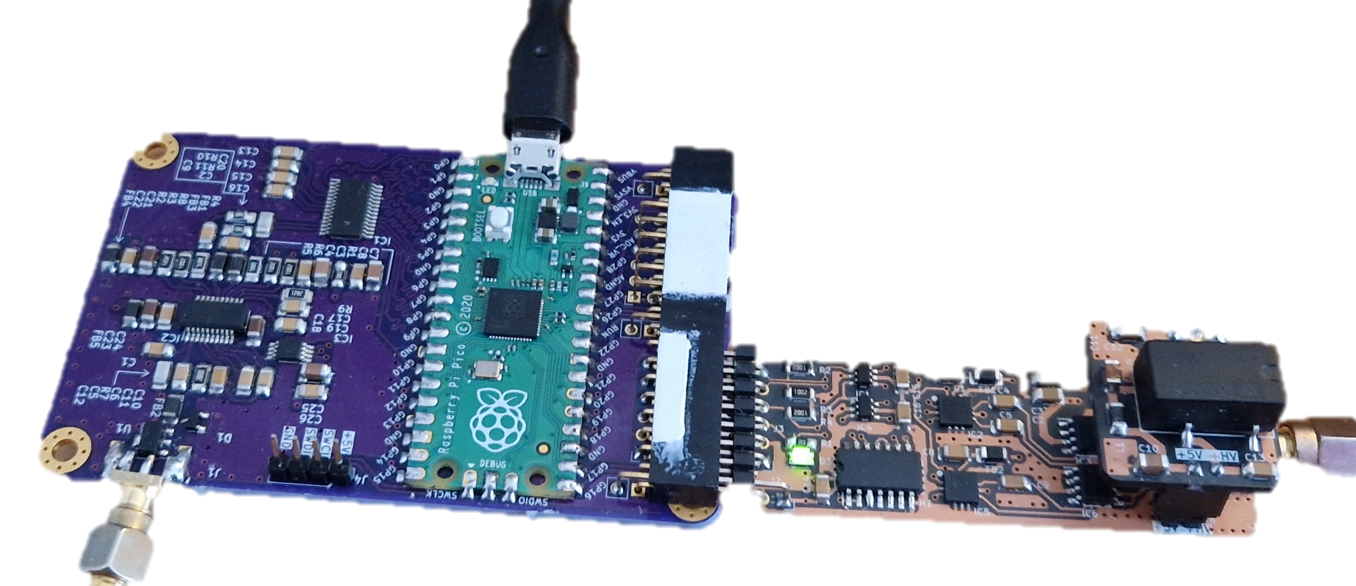
Motivation
Scientific Background
Design & POC
Initial Steps
DIY Ultrasound Probe Concept Design
Pic0rick Ultrasound Module (Open-source Project)
Ultrasound Probe Controller
Pulser Board ultrasound pulse generation
Raspberry Pico microcontroller
Probes with Co-axial options
Compatible with simple ultrasound transducers
Live process imaging board via Raspberry Pi 5
GitHub - kelu124/pic0rick: An rp2040-based acquisition board for pulse-echo ultrasound

Slide 4
Motivation
Scientific Background
Design & POC
Initial Steps
PCB Schematic Design of Ultrasonic system:
pic0Rick Ultrasound probe
Controller
4k monitor
Raspberry Pi 5
PMOD
Ultrasound
Transducer
RasPico

Slide 5
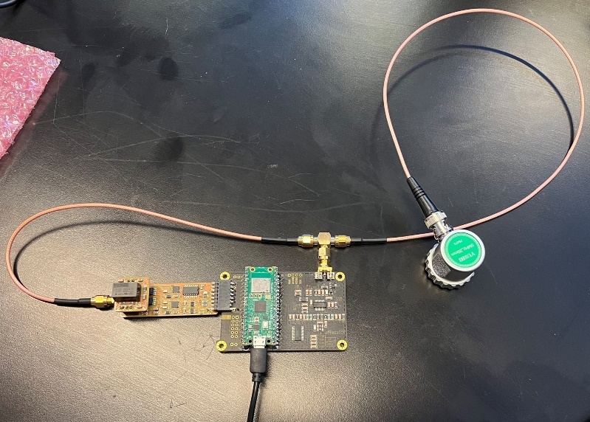
Motivation
Scientific Background
Design & POC
Initial Steps
POC Device after Designing, Printing, Constructing & Soldering
Simple Ultrasound
Transducer
2-5 MHz
RasPico
PMOD pulser
pic0rick
GitHub - kelu124/pic0rick: An rp2040-based acquisition board for pulse-echo ultrasound

Slide 6
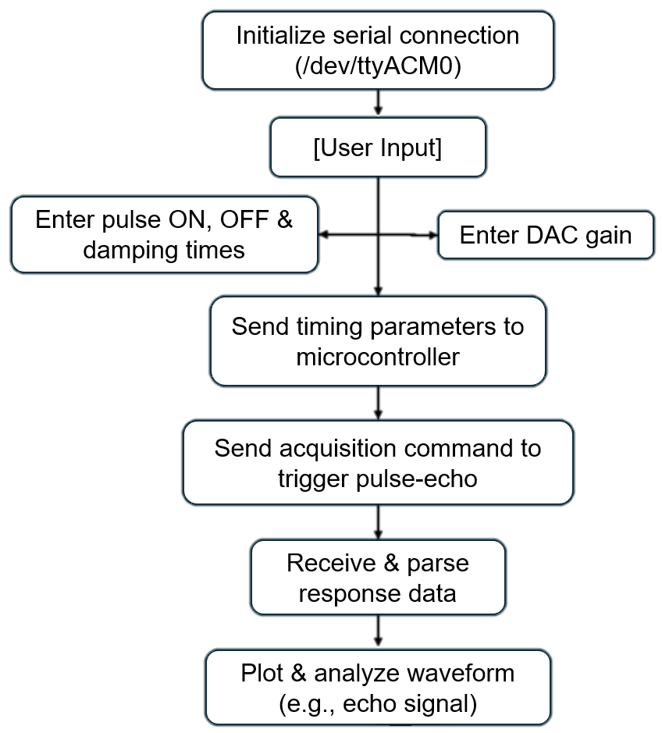
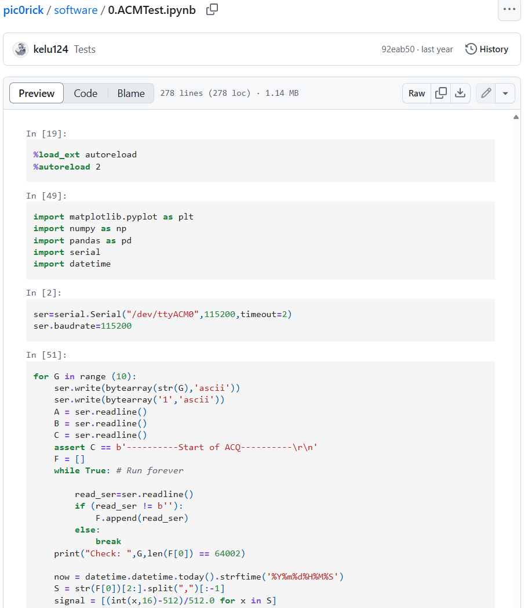
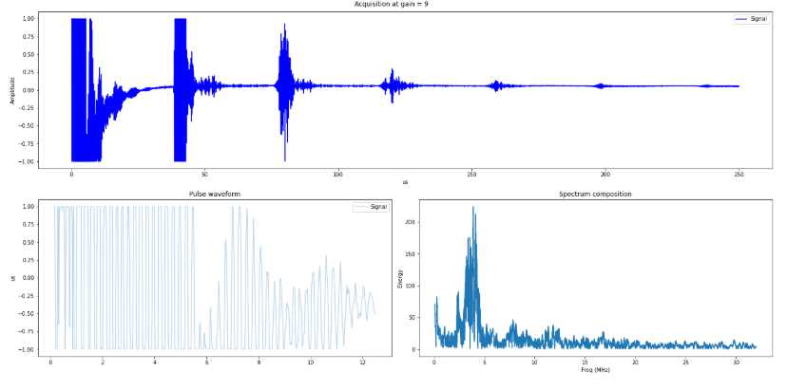
Motivation
Scientific Background
Design & POC
Initial Steps
Custom Live Ultrasound Transducer Acquisition Software
GitHub - kelu124/pic0rick: An rp2040-based acquisition board for pulse-echo ultrasound

Slide 7
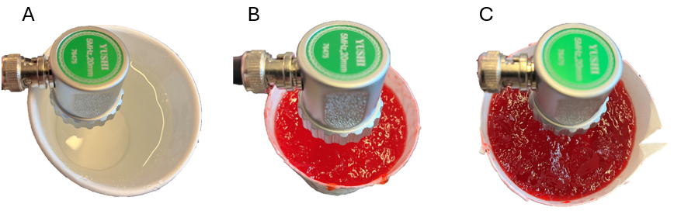
Motivation
Scientific Background
Design & POC
Initial Steps
Pic0rick Ultrasound System
Testing & validate the build electronic boards
Compare different ultrasound parameters in water vs. varying density of gelatin
water
0.75 g/L
1.0 g/L

Slide 8
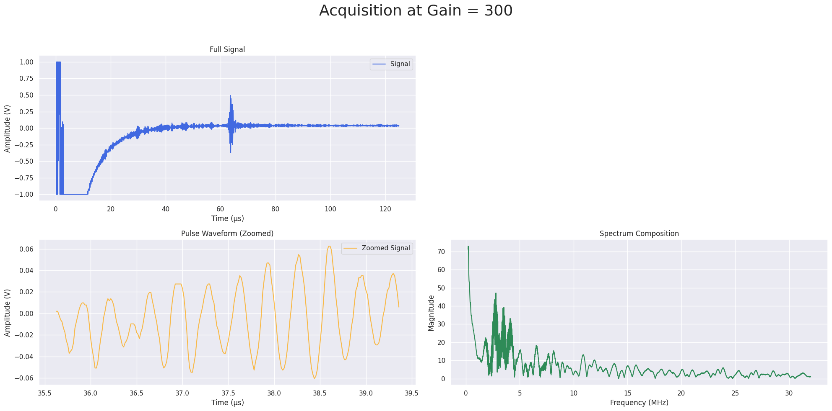
Motivation
Scientific Background
Design & POC
Initial Steps
Ultrasound Transducer Signal in Water
A
pulse echo
water
B
C
2-5 MHz

Slide 9
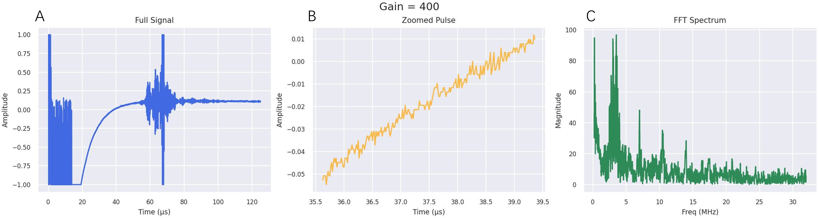
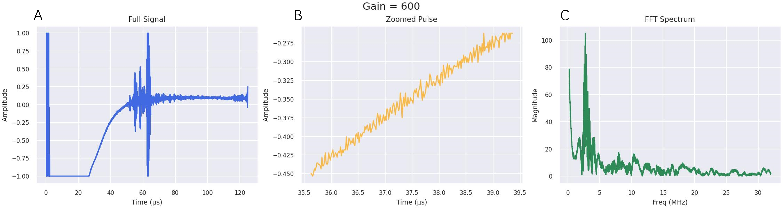
Motivation
Scientific Background
Design & POC
Initial Steps
Ultrasound Transducer Signal in Gelatin with 5 cm depth and varying density
pulse echo
0.75 g/L
D
E
F
pulse echo
2-5 MHz
1.0 g/L

Slide 10
Motivation
Scientific Background
Design & POC
Initial Steps
Thank you!
Questions?

